Slide 1


Drowning in to-dos?
Here’s your life raft:
25 ways to get things DONE
📌 Actionable | Practical | Proven
Start here

Slide 2

Overwhelmed. Distracted. Unproductive.
If this sounds like your day...
You’re not alone. But it doesn’t have to stay this way.

Slide 3
Your productivity breakthrough starts now
Here are 25 strategies to help you:
✅ Maximize time
✅ Stay focused
✅ Crush your goals

Slide 4
Quick Wins
🚀 Start with these quick wins
  Use the 2-Minute Rule
  Batch similar tasks
  Work in Pomodoro's (25/5 rule)
Small tweaks → big results

Slide 5
Small tweaks → big results
🧠 Strategic planning = laser focus
  Set SMART goals
  Plan tomorrow tonight
  Create a solid morning routine
Structure fuels success

Slide 6
Clear the Clutter
🧹 Declutter your space + mind
  Clean your workspace
  Use checklists
  Limit social media scrolls
Clear space = clear thinking

Slide 7
Prioritize What Matters
🎯 Focus on the right things
  Use the Eisenhower Matrix
  Set meeting time limits
  Say no more often
Not everything deserves your time

Slide 8
Control Your Time
⏳ Own your hours before they own you
  Use email filters
  Establish work/life boundaries
  Block distractions
Time isn’t lost—it’s taken

Slide 9
Master Your Mindset
🧘 Focus starts from within
  Practice mindfulness
  Embrace a growth mindset
  Visualize your success
Your mindset is your superpower

Slide 10
Power Productivity Hacks
💡 Go from busy to effective
  Learn speed reading
  Use productivity tools
  Find a productivity buddy
  Reward your wins
Momentum loves consistency

Slide 11
Keep Growing
📈 Long-term growth = daily habits
  Prioritize sleep, nutrition, and exercise
  Embrace failure as feedback
  Keep learning, keep leveling up
Build a life, not just a to-do list

Slide 12
Final Thought
Consistency beats intensity
Pick a few strategies.
Stick with them.
Watch your productivity soar.

Slide 13
Call-to-Action Slide
Upwards and forwards
— Sidney Pretorius
📍 www.theatriam.com
✅ Save this carousel
✅ Try one strategy TODAY
✅ Share with someone who needs a boost

Slide 14
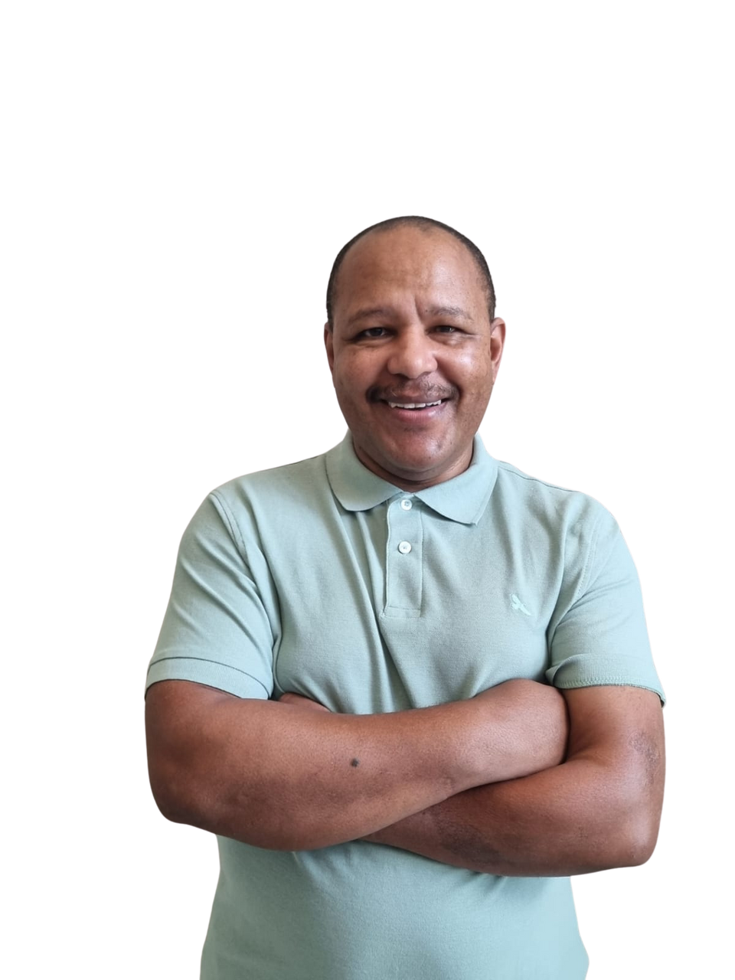
Follow and Share Sidney Pretorius for more Content like this
Sidney Pretorius

